Slide 1



SOFTWARE DEVELOPMENT PROFESSIONAL PROGRAM
Style Sheets & Simple Selectors

Slide 2





Style Sheets & Simple Selectors
Learning Objectives
Include CSS from an internal or external style sheet.
Use CSS selectors to target specific HTML elements.
Use CSS properties to style HTML elements.

Slide 3


Style Sheets & Simple Selectors
Cascading Style Sheets
Styling for the web!
Notes:
Cascading Style Sheets is the styling language used to design pages on the web.

Slide 4
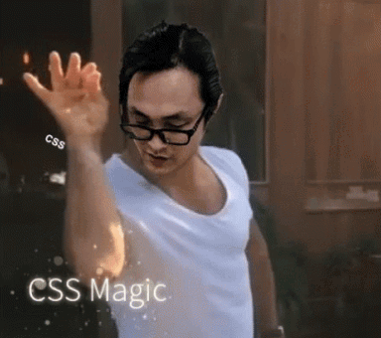
Style Sheets & Simple Selectors
Adding CSS to HTML
So how do we add CSS to our HTML document?

Slide 5
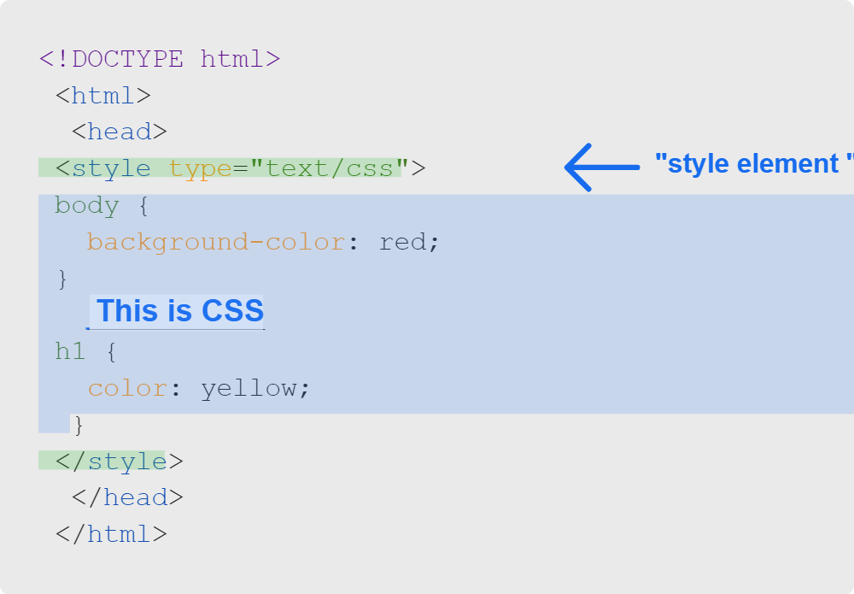
Style Sheets & Simple Selectors
Internal CSS
CSS can be embedded inside of HTML using the style tag
Notes:
CSS can be added internally to an HTML file using the style element within the head section.

Slide 6

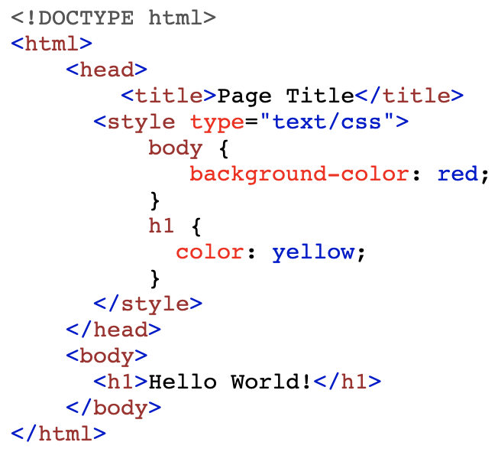

Style Sheets & Simple Selectors
Internal CSS
Notes:
<< Exercise 1-- Internal CSS >>

Slide 7

Style Sheets & Simple Selectors
Quiz: Internal CSS
What is the correct way to internally include the < style > tag in your HTML document?
A. Within the < head > tag with a type attribute of stylesheet
B. Within the < head > tag with a type attribute of css/text
C. Within the < body > tag with a type attribute of text/stylesheet
D. Within the < head > tag with a type attribute of text/css

Slide 8
Style Sheets & Simple Selectors
Quiz: Internal CSS
What is the correct way to internally include the < style > tag in your HTML document?
🚫 A. Within the < head > tag with a type attribute of stylesheet
🚫 B. Within the < head > tag with a type attribute of css/text
🚫 C. Within the < body > tag with a type attribute of text/stylesheet
✅ D. Within the < head > tag with a type attribute of text/css

Slide 9
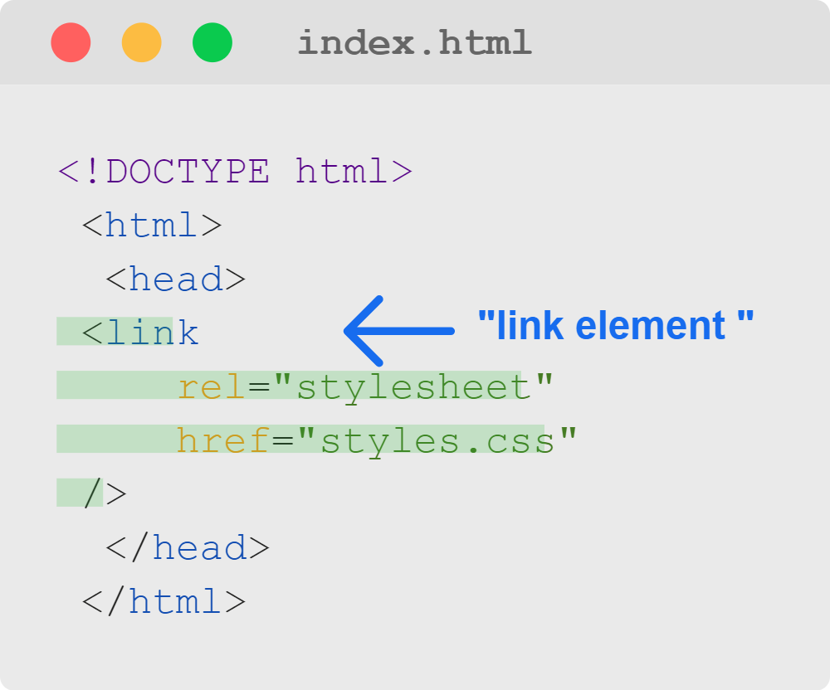
Style Sheets & Simple Selectors
External CSS
CSS from a separate file can be included in HTML using a link element

Slide 10
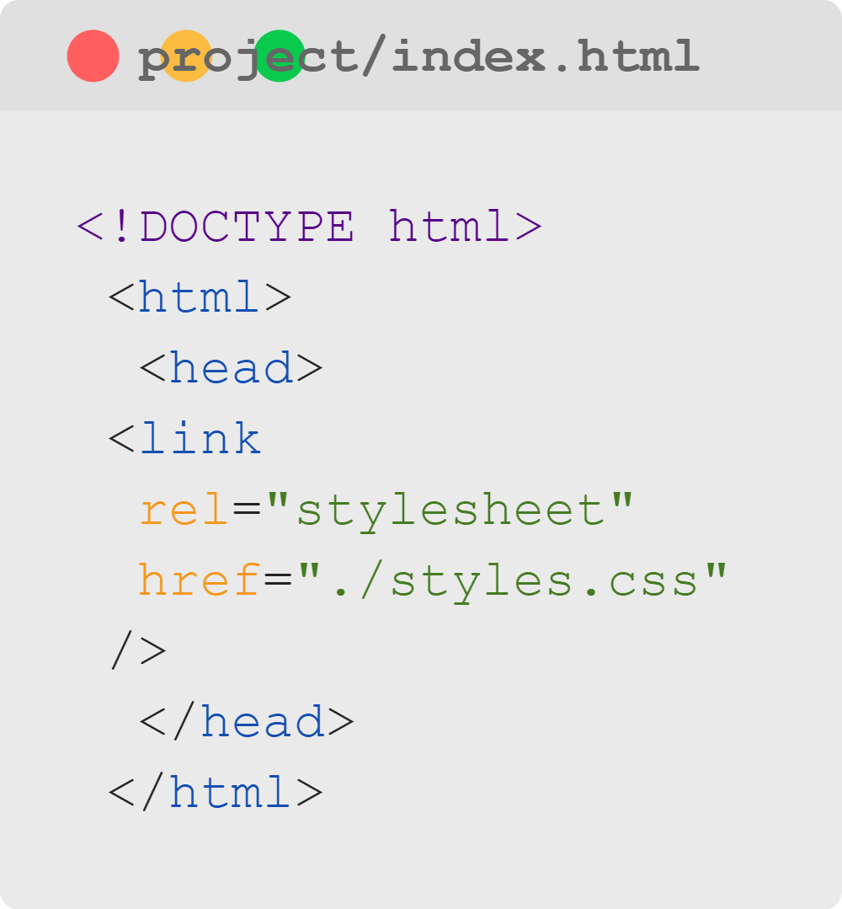
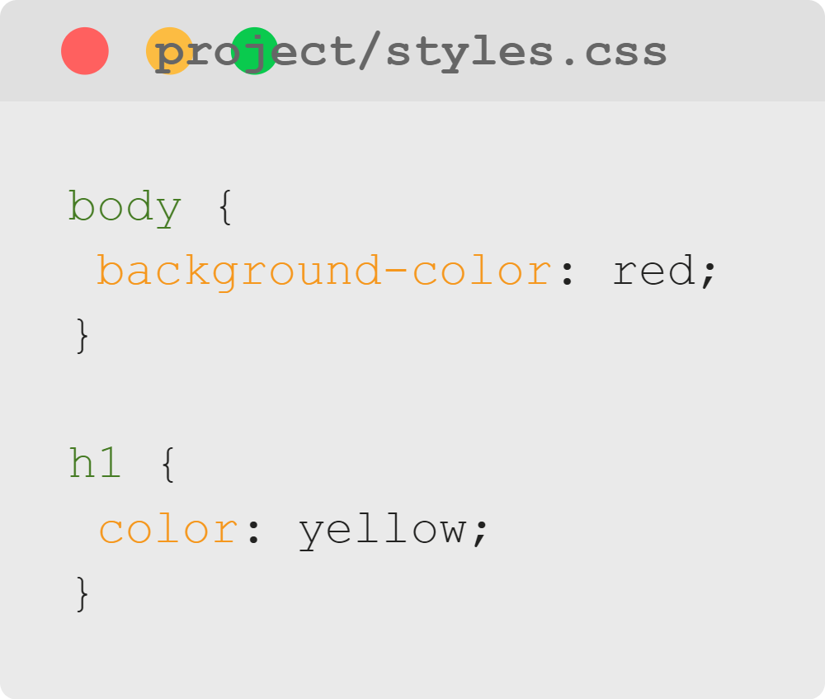
Style Sheets & Simple Selectors
External CSS
Output
Notes:
<< Exercise 2-- External CSS >>

Slide 11
Style Sheets & Simple Selectors
Quiz: External CSS
What tag should you use when including external css?
A. style
B. stylesheet
C. link
D. rel

Slide 12
Style Sheets & Simple Selectors
Quiz: External CSS
🚫 A. style
🚫 B. stylesheet
✅ C. link
🚫 D. rel

Slide 13
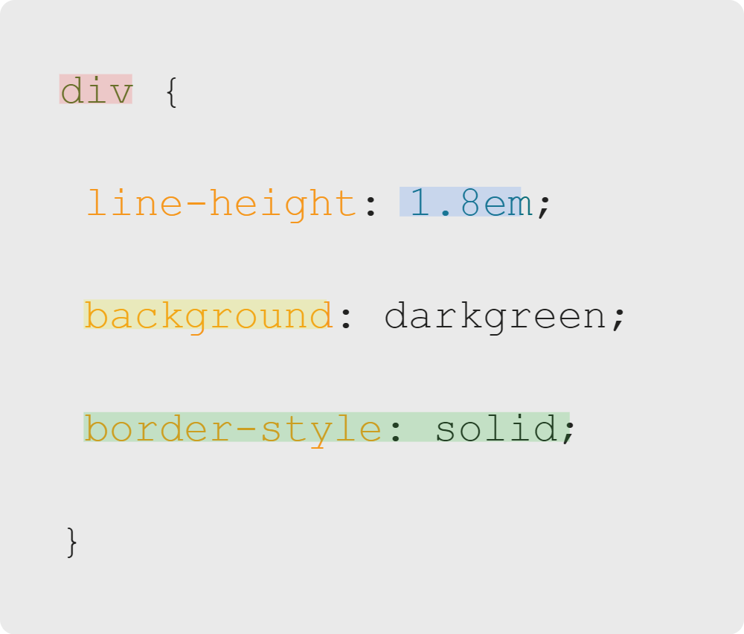

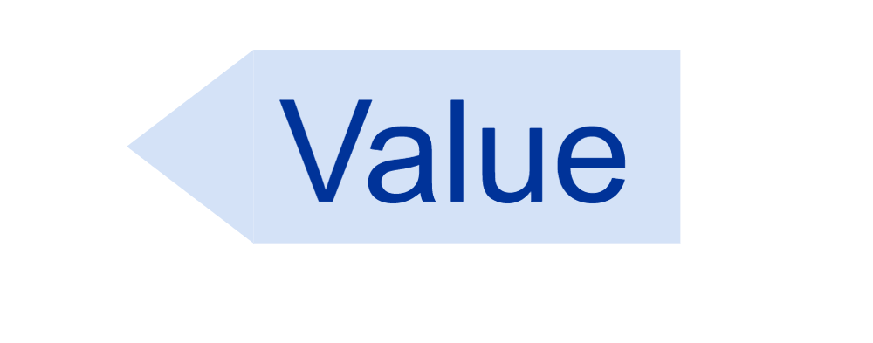


Style Sheets & Simple Selectors
How do we write CSS?
Using CSS rules:
Notes:
<< Exercise 3-- CSS Rules >>

Slide 14
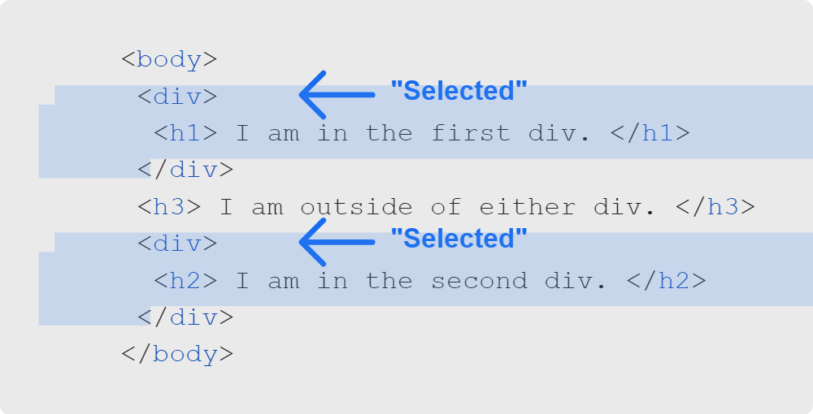
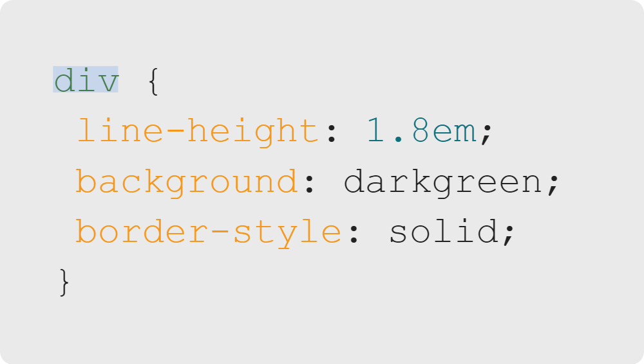
Style Sheets & Simple Selectors
Selectors
Notes:
The selector part of a CSS rule tells us which HTML elements are going to be selected for modification. Here, it's all div elements.

Slide 15
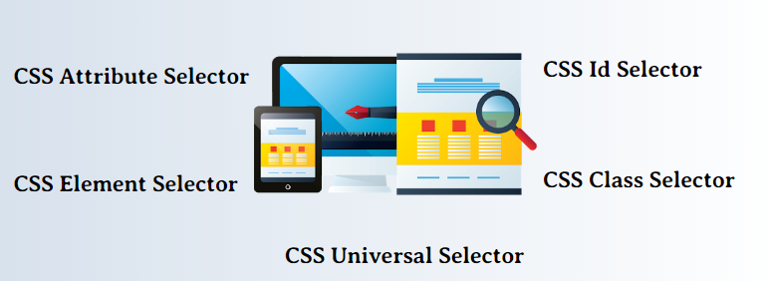
Style Sheets & Simple Selectors
Basic Selectors
Source: eduCBA
Notes:
Note that we won't review all of the basic selectors in this lesson,
but we'll look at a couple of the most useful, and learners can read about
the others on MDN

Slide 16
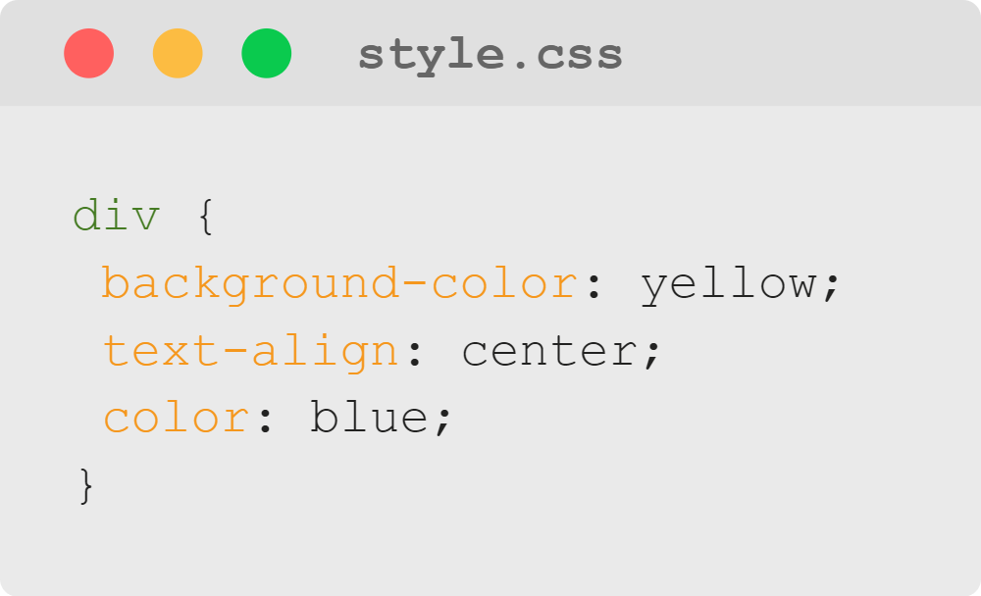
Style Sheets & Simple Selectors
Element Selector
Let's look at an example of an element selector.
Notes:
<< Exercise 4-- Element Selector >>

Slide 17
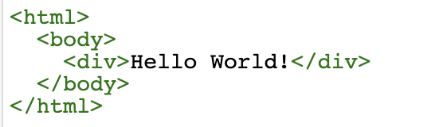
Style Sheets & Simple Selectors
Element Selector
HTML
Output

Slide 18
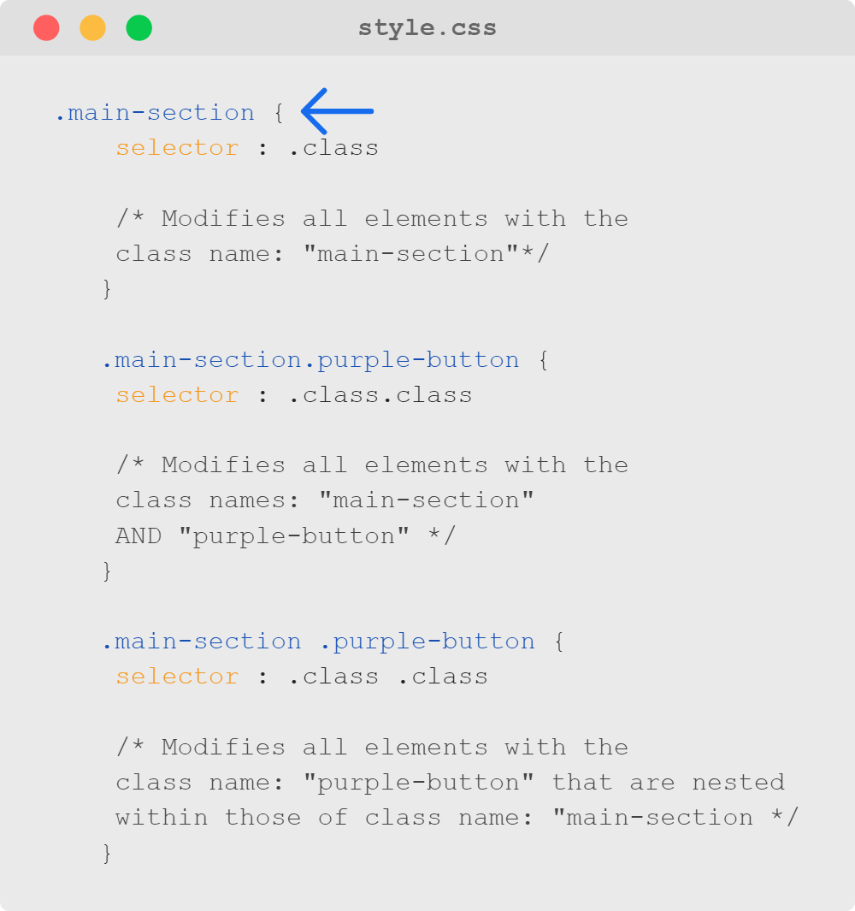
Style Sheets & Simple Selectors
Class Selector
The class selector modifies all elements in the entire HTML document with a certain class name.

Slide 19
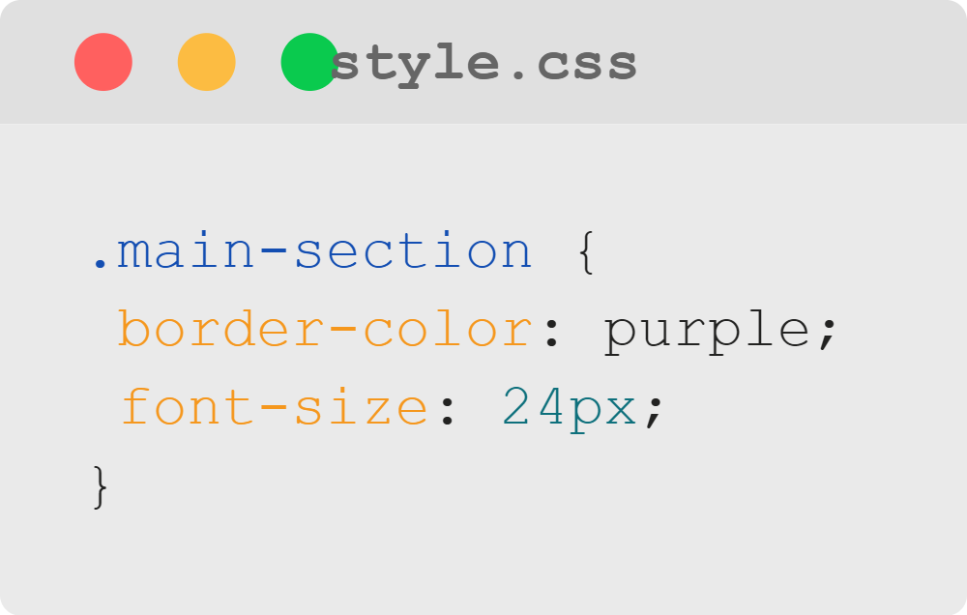
Style Sheets & Simple Selectors
Class Selector
Let's look at an example of a class selector.
Notes:
<< Exercise 5-- Class Selector >>

Slide 20
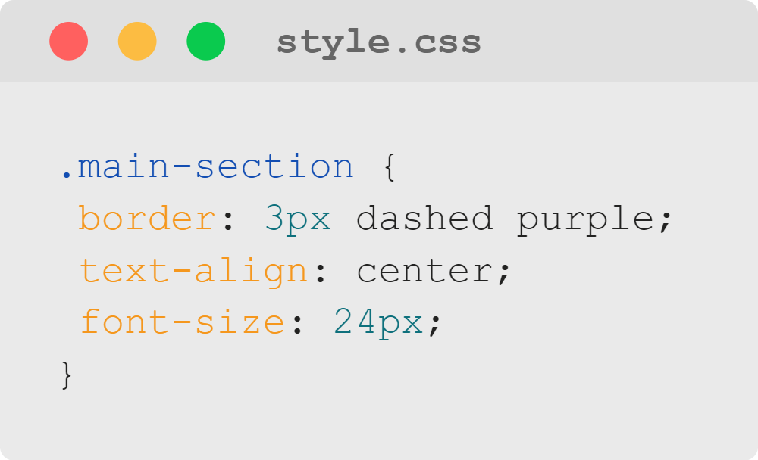
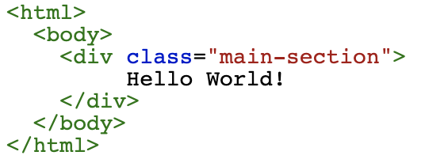

Style Sheets & Simple Selectors
Class Selector
HTML
Output

Slide 21
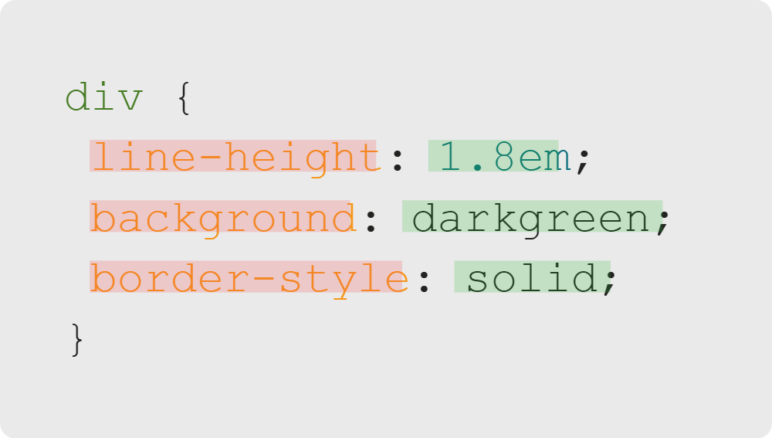
Style Sheets & Simple Selectors
CSS Declarations
The meat of CSS is what we do with the elements we've selected
Properties
CSS styling keywords
Values
Colors, dimensions, etc.

Slide 22
Style Sheets & Simple Selectors
Properties
Property | Description
background-color | Changes the color behind an element
border-radius | Adds rounded corners to an element
border-style | Adds a border around the element
font-family | Changes the font style for text within the element
Plus many, many more! Discover more CSS properties using W3 Schools Documentation
Notes:
There's no way we could review *every* CSS property here, but
we'll review a couple as an example of how CSS properties work in general

Slide 23
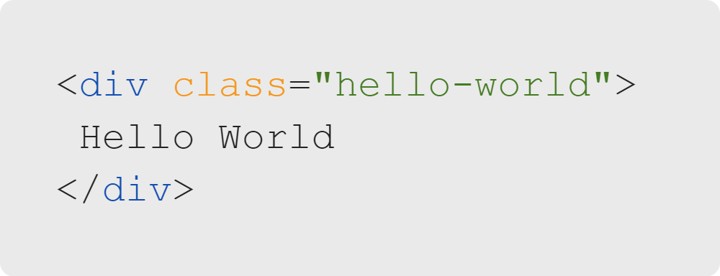

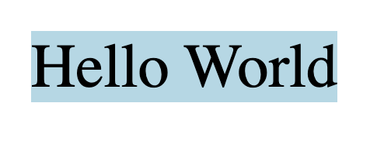
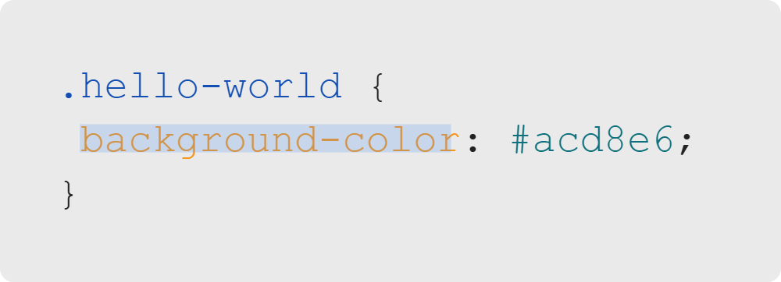
Style Sheets & Simple Selectors
Background Color
Notes:
The background-color property let's us change the color behind an element.
The value we use here is a hex color- we'll learn more about these in the extended course,
for now, all we need to know is that it references a specific color.
If you want to calculate a hex color, you can easily find a color picker online that provides
the color you select as a hex.
<< Exercise 6-- background-color property >>

Slide 24
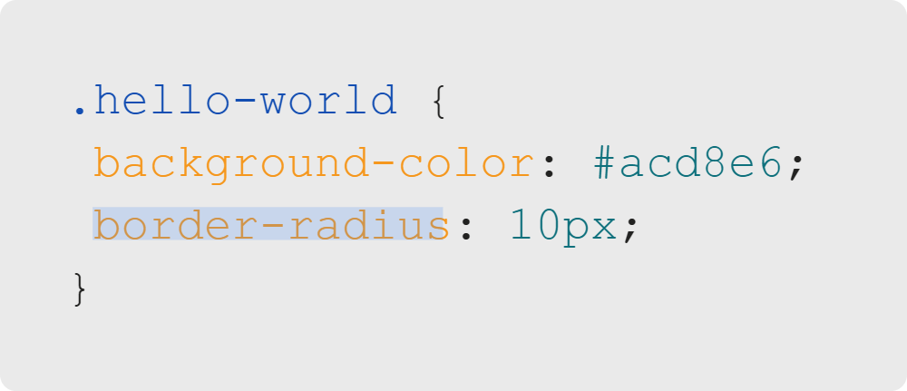
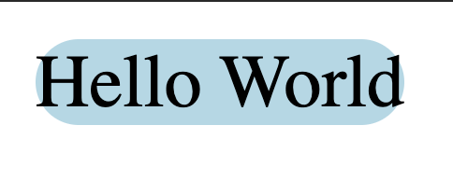
Style Sheets & Simple Selectors
Border Radius
+
=
Notes:
The border-radius property allows us to give an element rounded edges.
The value of this property is a number and then 'px' which is short for pixels.
This is a common pattern in CSS where we combine a number and unit of measure to express a 'distance',
in addition to px we can use other units of measure that we'll cover in the extended course.
<< Exercise 7-- border-radius property >>

Slide 25
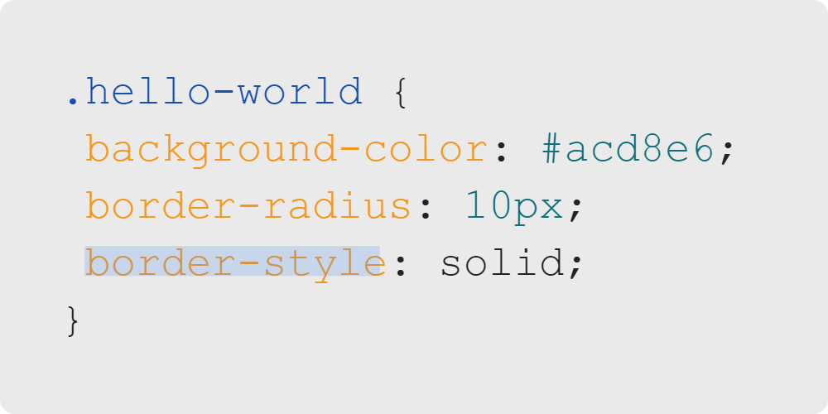

Style Sheets & Simple Selectors
Border Style
+
=
Notes:
The border-style property allows us to give an element a border.
The value of this property 'solid'- a keyword specific to this property.
Instead of solid, we could use:
* dashed
* double
* dotted
* groove
* ridge
* inset
* outset
This is the third, and final basic pattern for css properties, where rather than a color or a measurement,
we express the value of a property as one of several pre-defined css keywords.
<< Exercise 8-- border-style property >>

Slide 26


Style Sheets & Simple Selectors
What's Next?
My Future in this Career
Notes:
Let's take a step back for a moment to discuss what's next in your career journey.

Slide 27

Style Sheets & Simple Selectors
What's Next?
Who are our learners?
Notes:
The goal is for learners to see themselves in the program and the learners who have graduated from the program
so they feel like they fit.
Reflect back on previous 3 days of career focus content and review key points covered.
Ask students to share their background and why they are in the program and make connections to their goals
and the courses being offered.
Share the data and information, tying it to the some of the examples that were given.

Slide 28
Style Sheets & Simple Selectors
What's Next?
Learners who finish our program:
Go from beginners to Jr. Web Developers in 10 months
Gain experience in JavaScript, NodeJS, Express, and Python
Become full-stack web developers, software engineers, front-end developers, and more
Enter an industry with 22% job growth and average salaries of $110,140
Source: Bureau of Labor Statistics
Notes:
Sources:
https://www.bls.gov/ooh/computer-and-information-technology/software-developers.htm#tab-5
https://www.bls.gov/ooh/computer-and-information-technology/software-developers.htm#tab-6
Ensure learners know that while the future salary is not the only concern when deciding what field to enter, they
are making a sound financial decision for themselves.

Slide 29

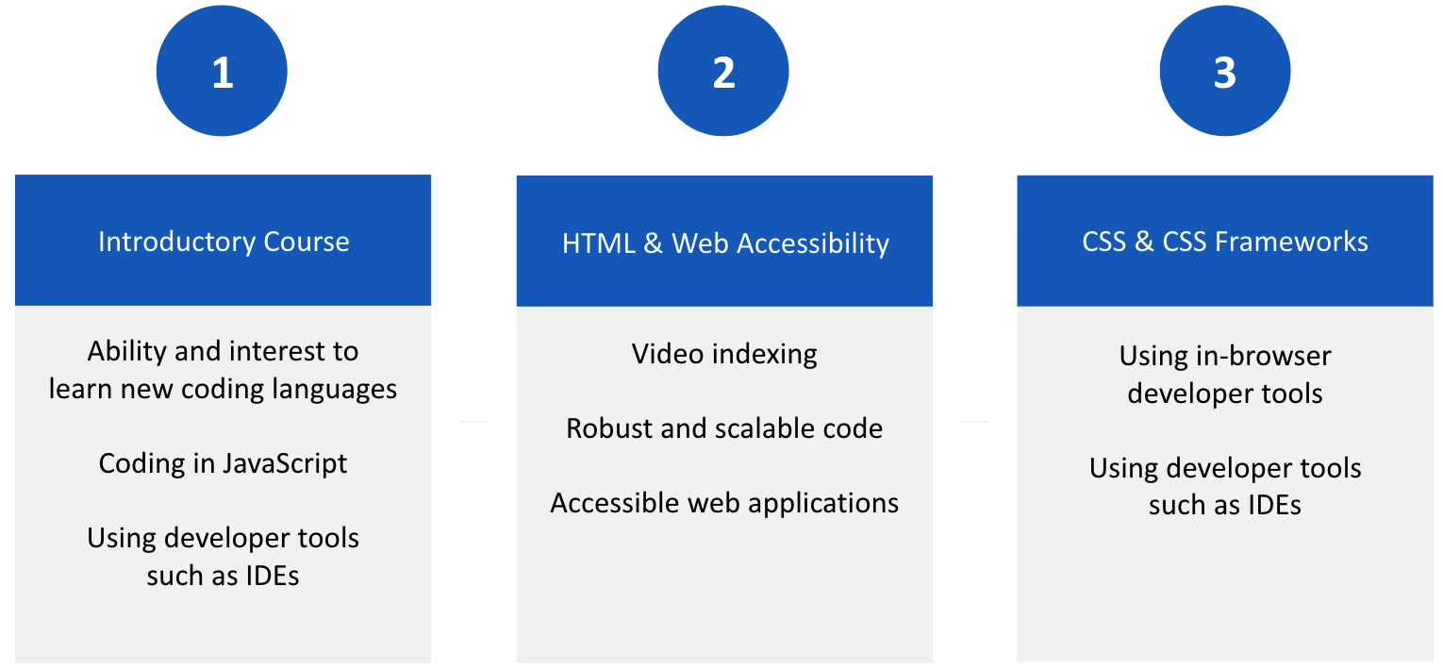
Style Sheets & Simple Selectors
Following Your Future
Notes:
The goal is for learners to see how the bootcamp will meet and/or exceed the requirements to land a job in the field.
Share the job description and the grid with students.
Explain that by the end of this program they will have met the skills that are being asked for by the job.

Slide 30
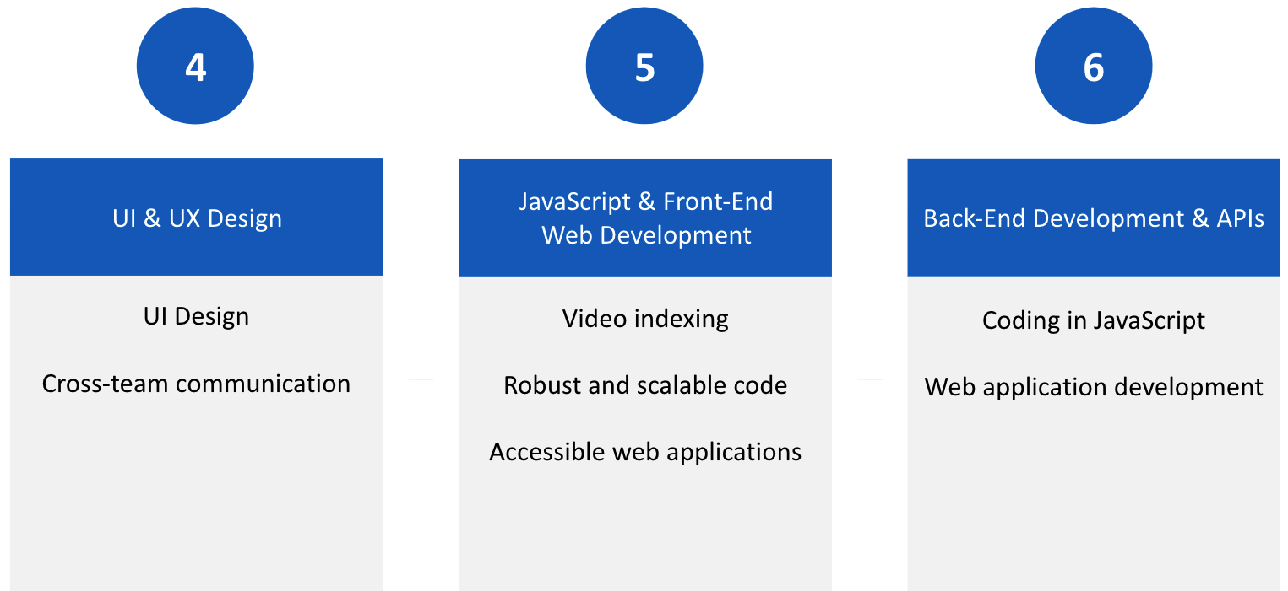
Style Sheets & Simple Selectors
Following Your Future

Slide 31
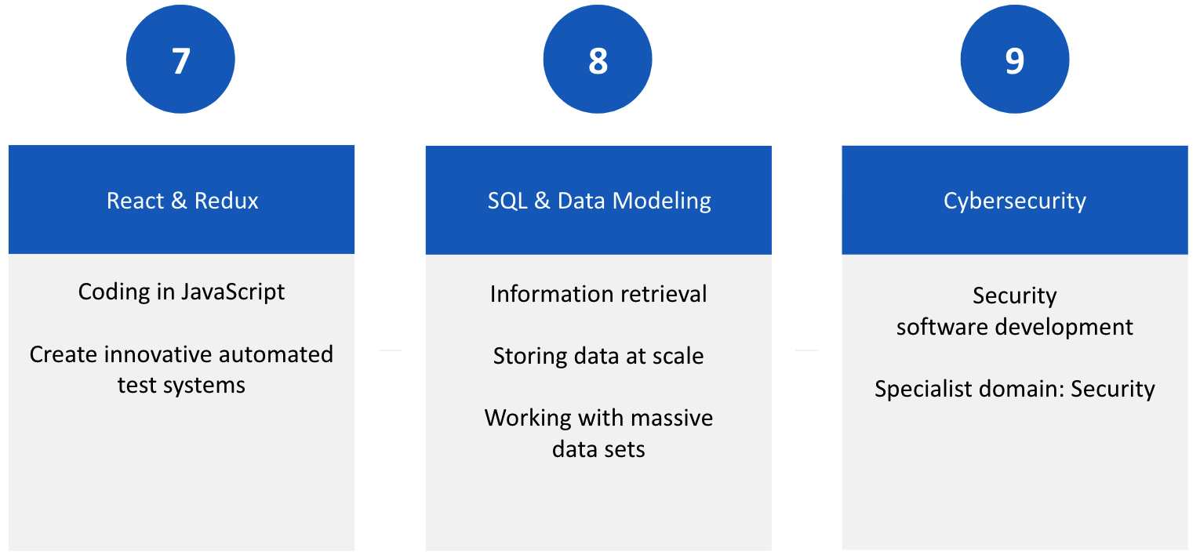
Style Sheets & Simple Selectors
Following Your Future

Slide 32
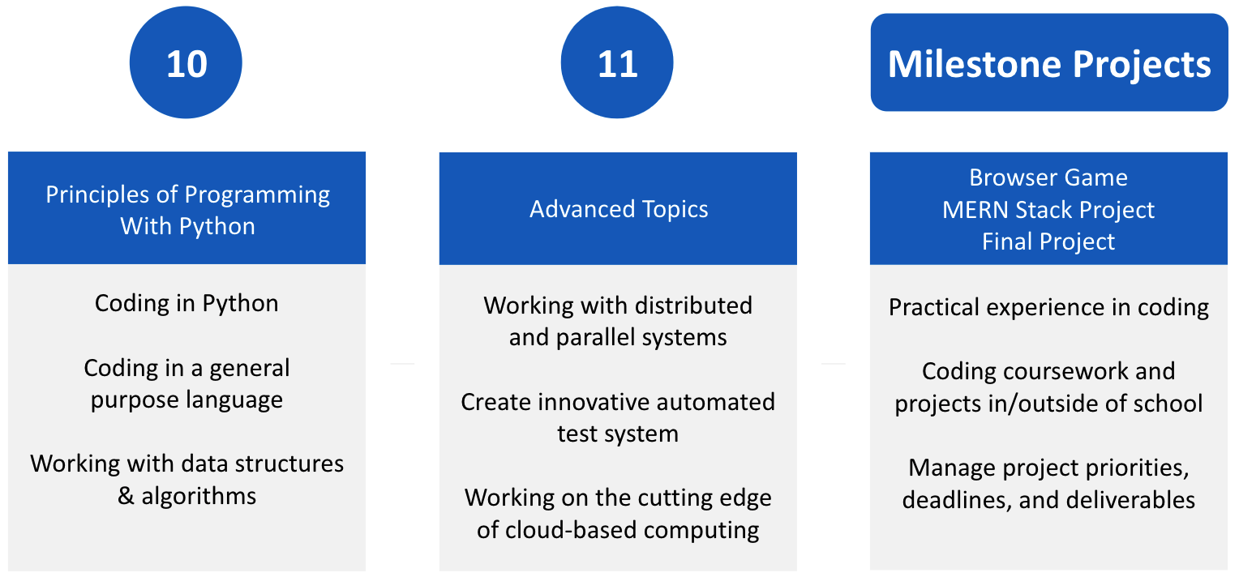
Style Sheets & Simple Selectors
Following Your Future

Slide 33

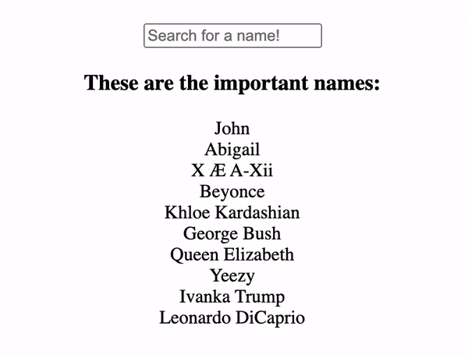
Style Sheets & Simple Selectors
WOW Factor
A look inside the job:
Full-Stack Web Developer
Notes:
One thing someone might do in the position of a Full-Stack Web Developer is build a smart, filterable search bar.
Take some time to describe some other tasks this person might do as well.
Do you do something like this in your own role? Tell learners all about it!

Slide 34
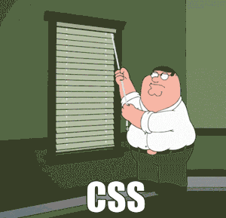
Style Sheets & Simple Selectors
You've Got This
Today you have learned about:
Style Sheets & Simple Selectors
Internal CSS
External CSS
CSS Selectors
CSS Properties
Notes:
Let's practice writing CSS by making a super sharp personal portfolio website!

Slide 35

Style Sheets & Simple Selectors
How's it going?
Tell us about your experience in the Introduction to Software Development course.
Following the Intro to HTML and CSS Quiz, please complete the Experience Check-In Survey in Canvas.
Notes:
<< Direct learners to complete the Experience Check-In survey at the end of this module.
The survey must be completed to gain access material in the next module of the course. >>

